Slide 1
BCSE401L: Internet of Things Module-5: Smart Device Localization, Clustering and Data Fusion
Dr. Anisha Natarajan
Assistant Professor
School of Electronics Engineering
anisha.natarajan@vit.ac.in

Slide 2
Introduction
Localization algorithm estimates the position, coordinates, or location of a smart device.
A simple solution for localization and tracking is to use Global Positioning System (GPS). However, the cost and energy consumption of GPS is high.
Additionally, GPS works well in line-of-sight scenarios like open space, not in underground or complex apartments.
The applications of localization methods include sensing, monitoring, surveillance, and tracking.

Slide 3
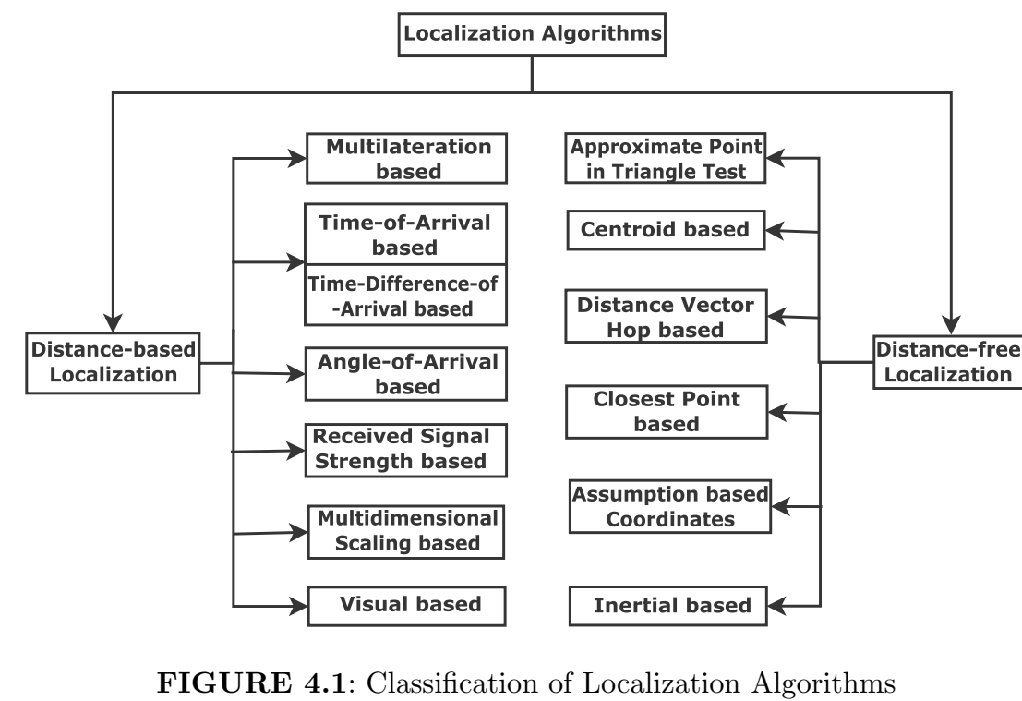
Taxonomy of Localization Algorithms

Slide 4
Taxonomy of Localization Algorithms
Localization methods utilize the knowledge of the locations of a small subset of nodes.
The node that is aware of its location is known as an anchor, beacon, source, or landmark.
Localization is a one-time process for a static smart device, whereas tracking is the continuous localization of the mobile smart device over time.
Localization methods can be classified as distance-free and distance-based methods in the literature as shown in Figure 4.1.
Distance-based localization methods utilize the distance between the anchor and unknown node.
On the other hand, distance-free methods utilize only connectivity information.
Distance-based methods are fine-grained localization methods, whereas, distance-free methods are coarse-grained.
A localization method can be chosen based on whether we need coarse-grained resolution, say, (± 5 m) or fine-grained resolution, say, (± 10 cm).

Slide 5
Distance-based localization methods
Distance-based methods are based on multilateration, Time-of-Arrival (TOA), Time-Difference-of-Arrival (TDOA), Angle-of-Arrival (AOA)/Directionof-Arrival (DOA), Received Signal Strength (RSS), Multidimensional Scaling (MDS), and visual information as shown in Figure 4.1.
Localization algorithms using TOA and TDOA require precise synchronization.
AOA and DOA-based algorithms need special hardware to estimate the angle at which the signal arrives at the antenna array.
The time of arrival (TOA) method performs localization using the information about the time of arrival of the signal from different anchors.
However, TOA requires a reference timestamp to synchronize the local clock of the nodes.
To overcome this issue of reference offset, a time difference of arrival (TDOA) method is used.
TDOA is based on the principle of the time difference of arrival of the anchor signals at a pair of nodes.
In this method, one of the anchors is generally taken as a reference node.
The TDOA method does not require synchronization between anchors and the unknown node.

Slide 6
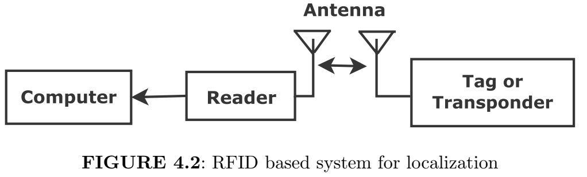
Localization using Received Signal Strength (RSS)-RFID based positioning
Smart device localization using RSS provides a cost-effective solution.
The RSS-based approach is also leveraged in Radio Frequency Identification (RFID) based positioning, which is suitable for IoT networks.
The RFID based technique uses tag or transponder and reader or interrogator to locate the objects as shown in Figure 4.2.

Slide 7
RFID based positioning
The RFID reader acts as a transceiver that detects and receives the RF wave originating from the RFID tag.
The energy of RF signals decreases exponentially with the distance.
The RFID reader is then connected to computing devices.
The computing devices estimate the location of the objects using RSS signals.
The RSS-based algorithm is marginally inaccurate, however, RSS measurements are easily accessible and low-cost.
Hence, an RSS-based localization algorithm is suitable for IoT networks.

Slide 8
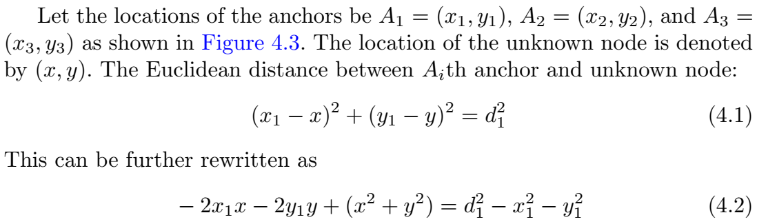
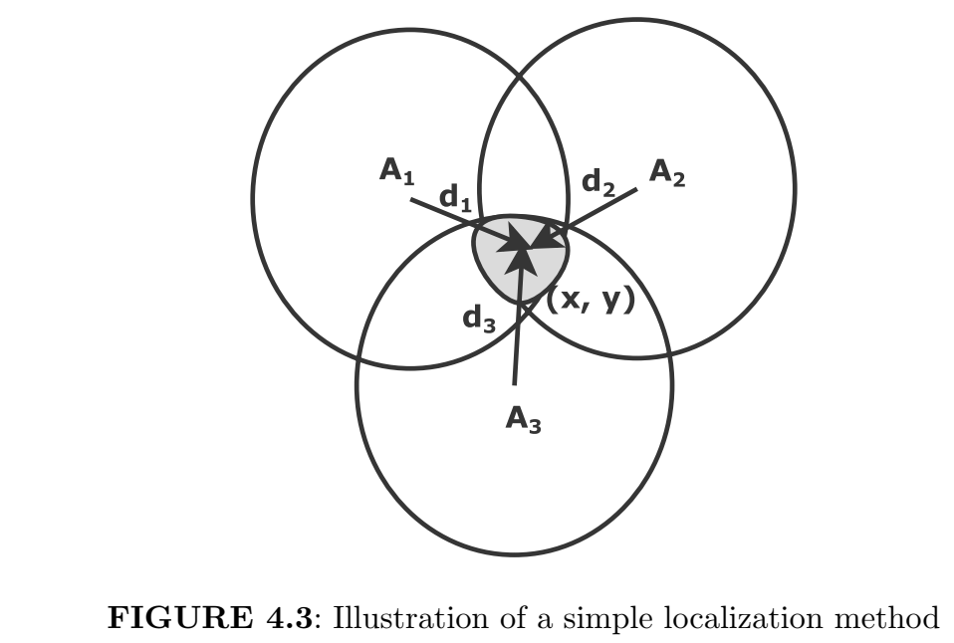
Multilateration based localization

Slide 9
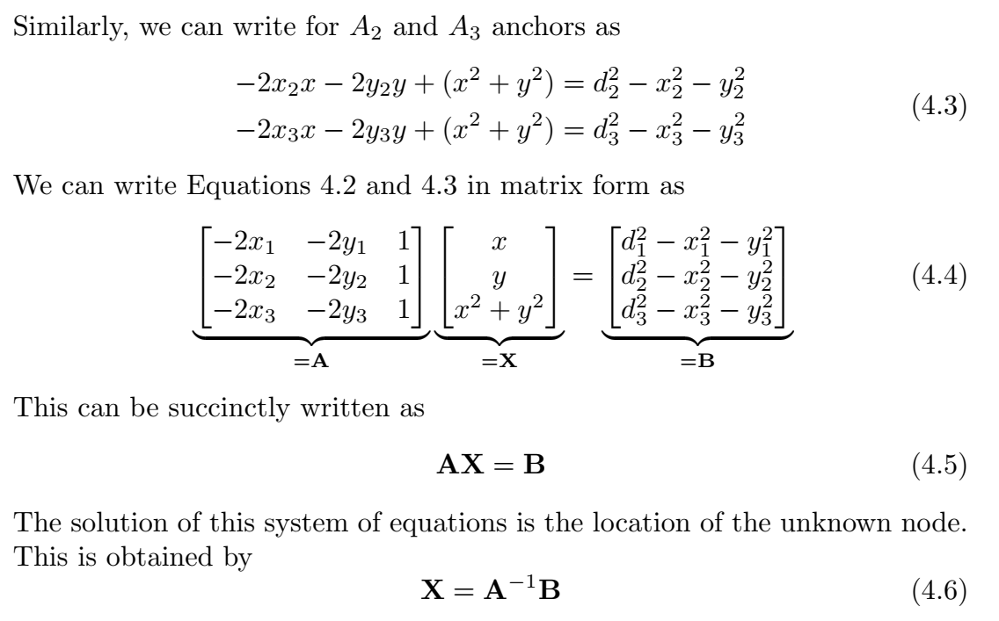

Slide 10
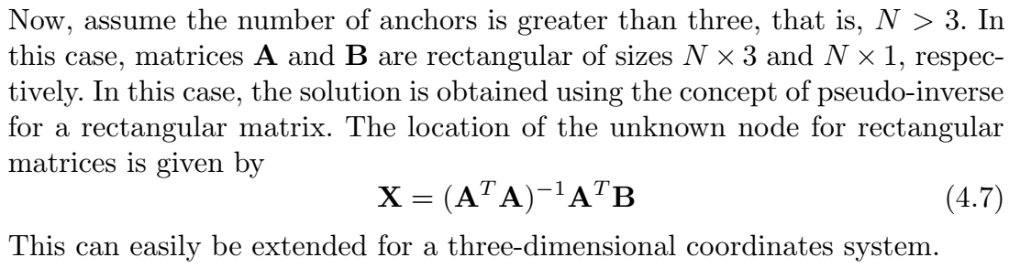

Slide 11
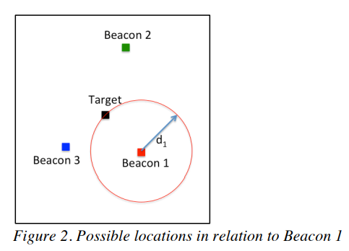
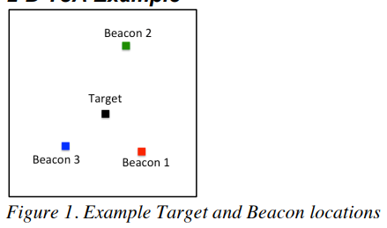
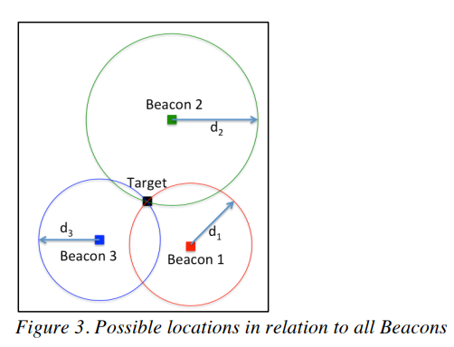


Basics of Time of Arrival based Localization

Slide 12
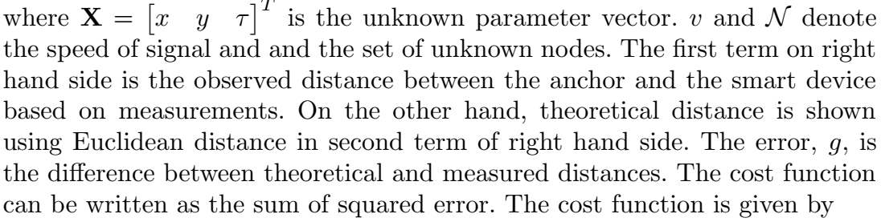

Time-of-Arrival based localization
We know that speed multiplied with time elapsed gives the distance between transmitter and receiver. The difference between theoretical and observed distances is given by:
where w is the confidence parameter between 0 and 1. The expression is the function of the unknown node location. The wi is the weight of the ith anchor and the smart device.

Slide 13
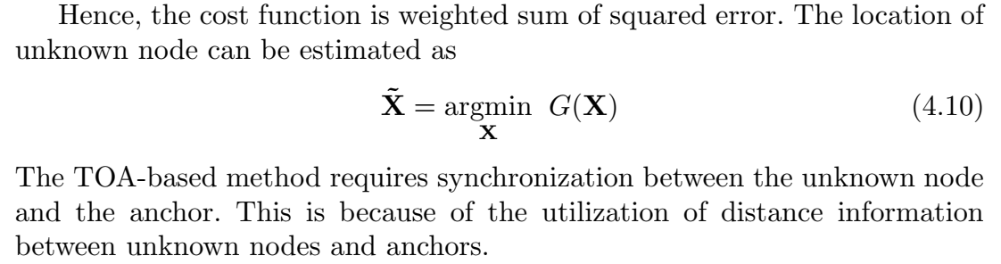
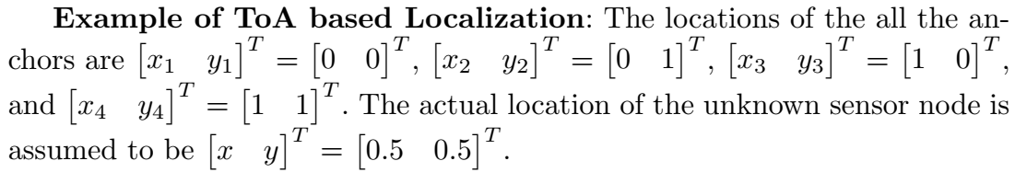

Slide 14
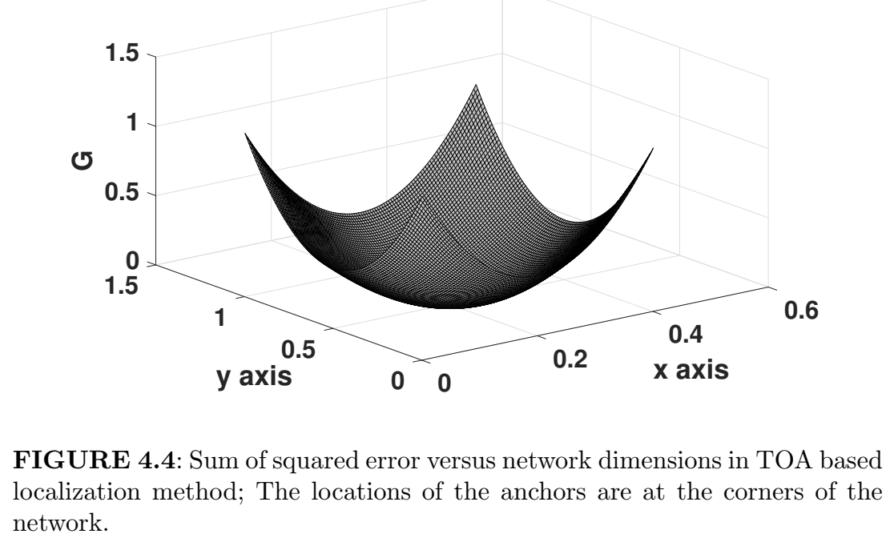

Slide 15
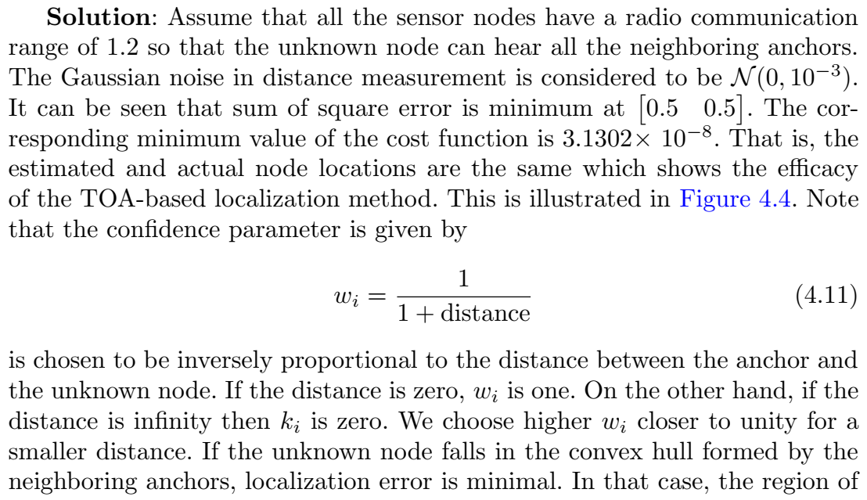

Slide 16
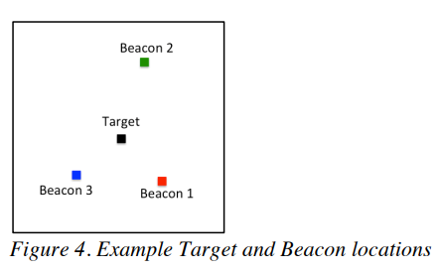

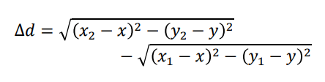
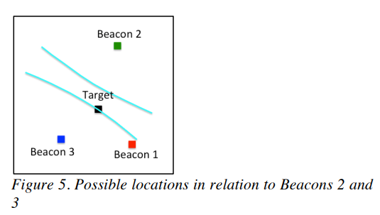
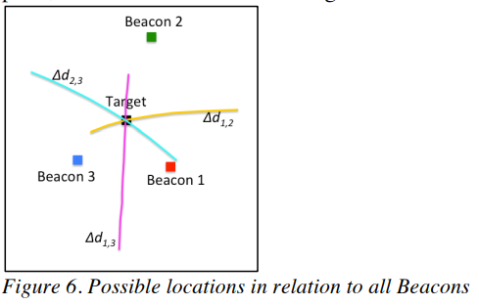
Time Difference of Arrival based localization (TDoA)

Slide 17
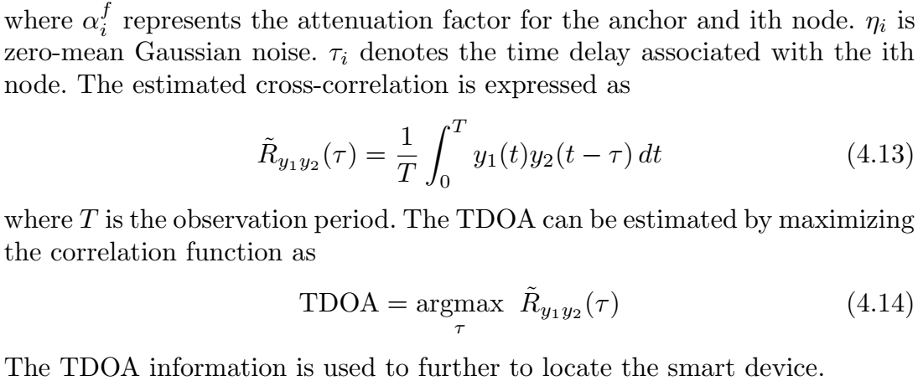
Time difference of arrival based localization
We explain Time-difference-of-arrival (TDOA) based localization now. The received signals at ith unknown node is given by:

Slide 18
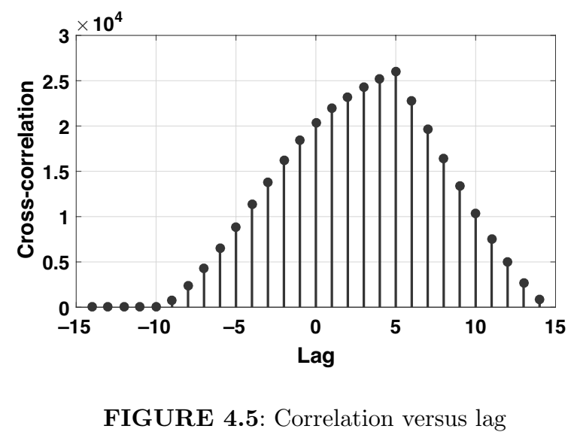
Example of TDoA based localization: Two signals y1(t) and y2(t) are utilized for computing the cross-correlation. We consider 10 samples and 15 samples, respectively, in y1(t) and y2(t). The maximum correlation occurs when the lag is 5 as shown in Figure 4.5. This is expected since the difference between the number of samples in those two signals is 5.
The difference between TOAs of pair of nodes, that is, TDOA is utilized herein for obtaining the location of unknown sensor node. It requires precise synchronization among anchors. However, it does not require synchronization between the unknown node and anchors. It may be noted that TDOA is an efficient estimator as compared to the TOA-based method.

Slide 19

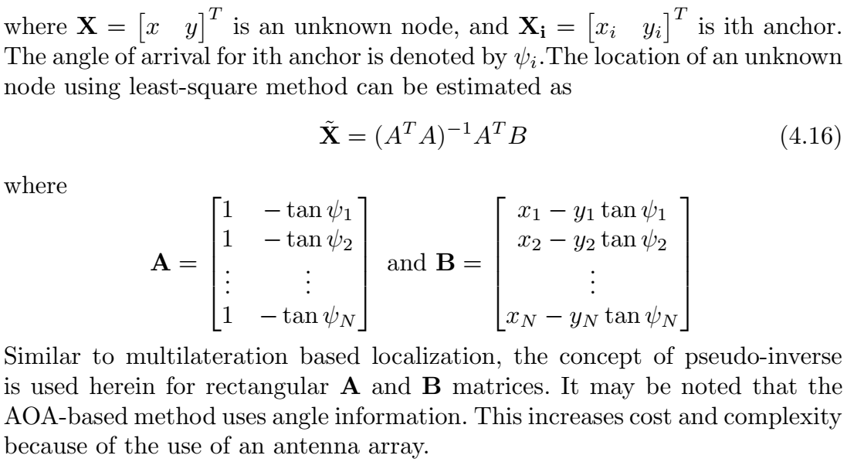
Angle of Arrival based localization
We first use trigonometry and geometry in Angle-of-Arrival (AOA) based localization. The angle and location relationship between the unknown node and anchor can be expressed as:

Slide 20
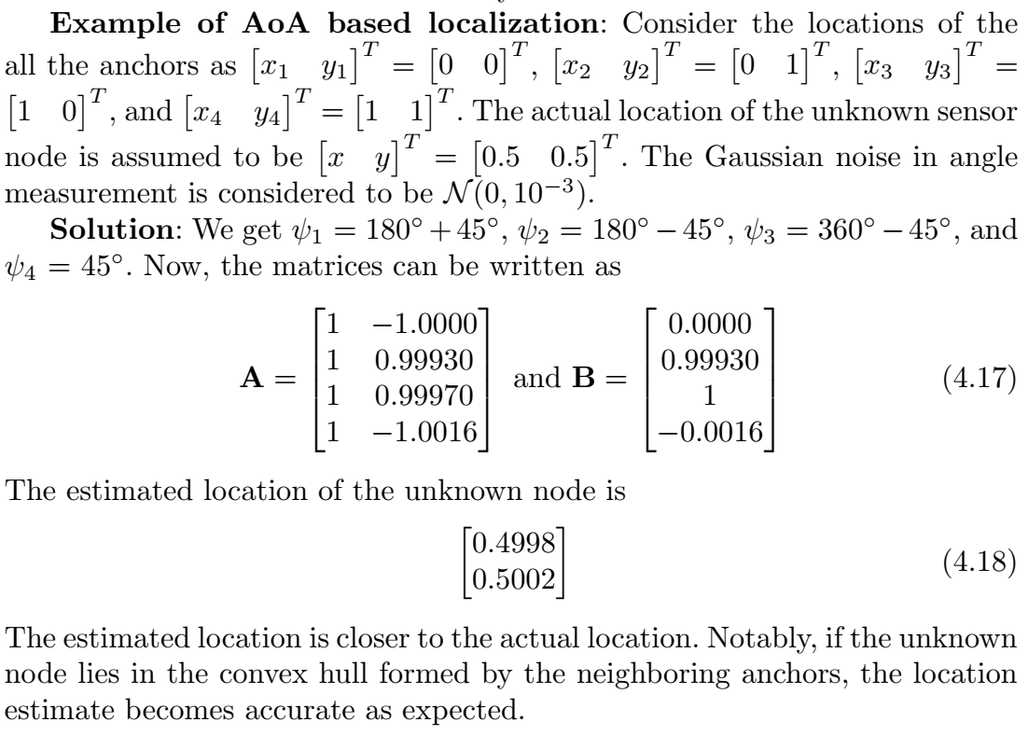

Slide 21
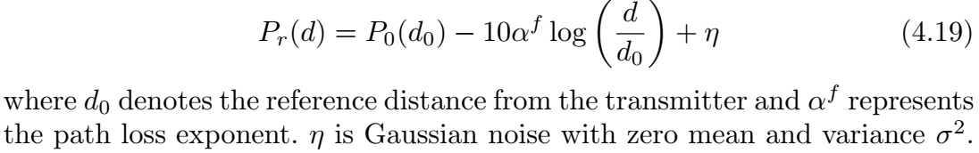
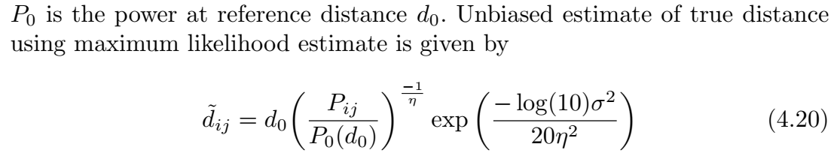
Received Signal Strength based localization
We discuss next Received Signal Strength (RSS) based localization. The RSS measurements at the unknown node due to an anchor can be expressed as
RSS is a low-cost measurement and it depends upon the wireless channel. It may yield large errors because of the requirement of an accurate propagation model. We can also use the least-square method to estimate distance.

Slide 22
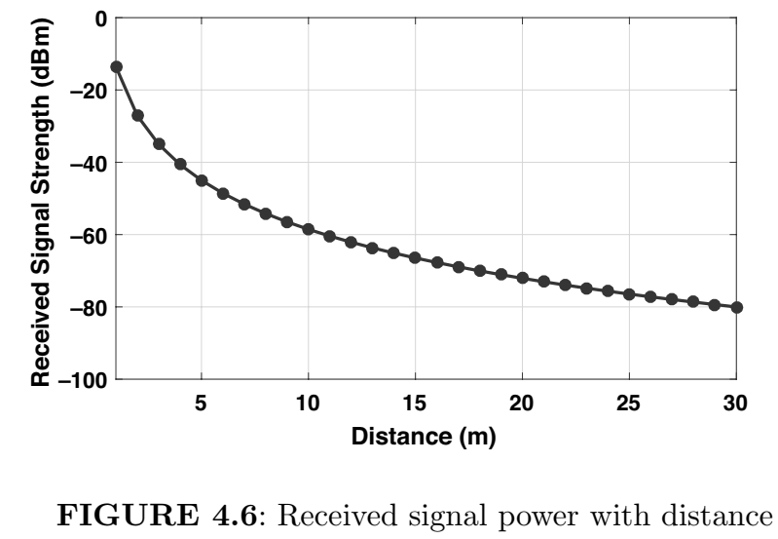
Example of RSS based localization: The path loss exponent η varies between 2 for free space to 6 for cluttered environment. This can be also estimated given the measurements. We consider η = 4.5, d0 = 1 m. The received power is the function of transmitted power, distance, antenna parameter, and the state of the channel.
Given the received signal power, we estimate the distance and vice-versa. The received signal power decreases with the distance between the anchor and the unknown node as shown in Figure 4.6. Received signal strength below some threshold like -80 dBm or -90 dBm is generally considered to be the noise floor. This varies depending upon the specifications of the hardware and environmental conditions.

Slide 23
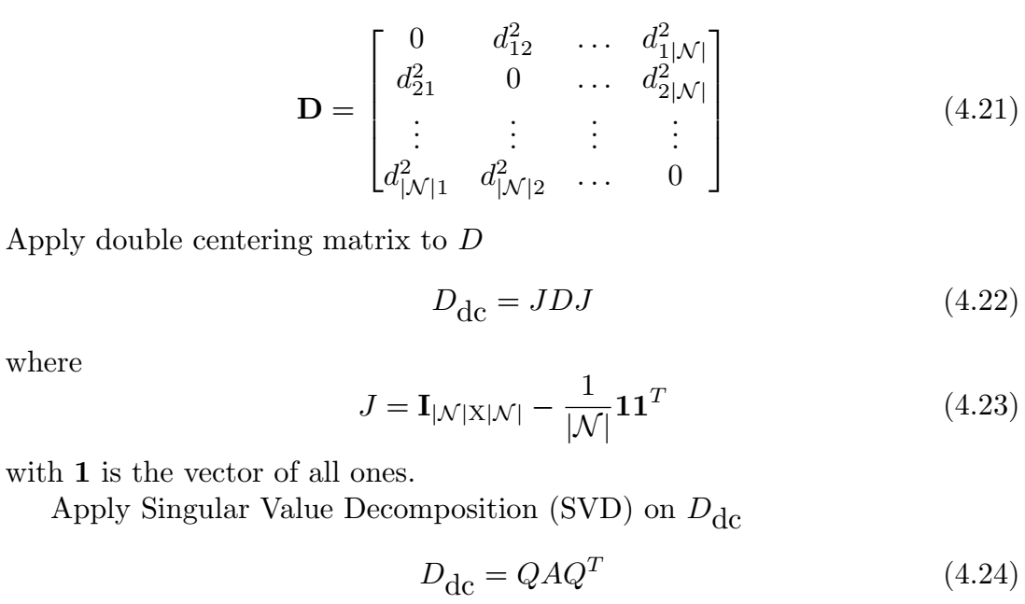
Multi Dimensional Scaling Based Localization
The algorithm based on the MDS computes the location of the unknown node, given the set of distances between each pair of nodes. The squared distance matrix is given by

Slide 24
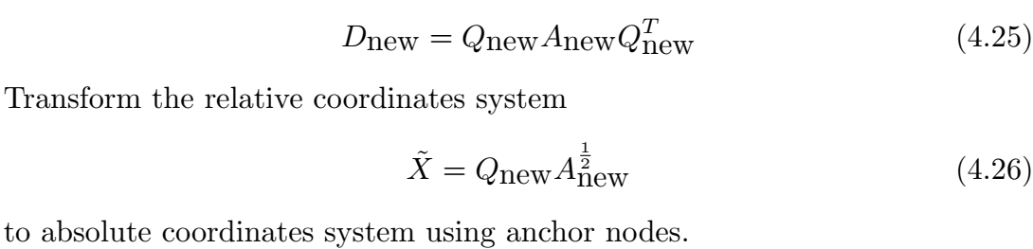
where A is the diagonal matrix having each element as eigenvalue and Q a matrix corresponding to the eigenvector. Choosing the first two eigenvalues and the corresponding eigenvectors for two-dimensional coordinates system

Slide 25
Distance-free Localization Methods
The distance-free based localization has low complexity than the distance-based method.
Distance-free methods use connectivity information and yield coarser location estimates.
Distance-free localization methods are based on distance-hop or geometric configuration of sensor nodes.
These localization methods are good for coarse location in a large IoT network.

Slide 26
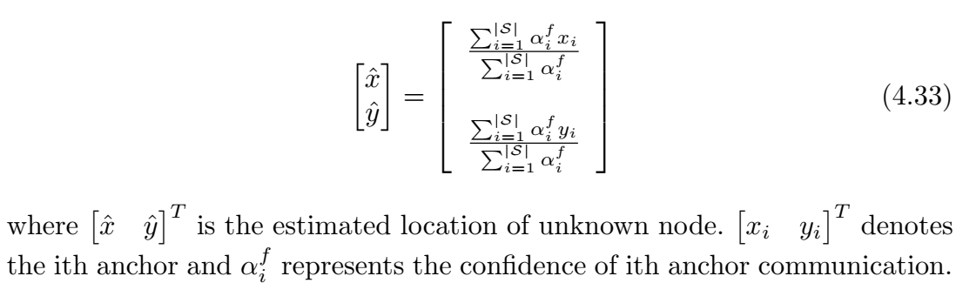
Centroid-based Localization
The centroid based localization is the most basic localization technique.
This is very simple and effective for coarse location. The centroid-based localization method for sufficiently large number of anchor nodes is given by

Slide 27
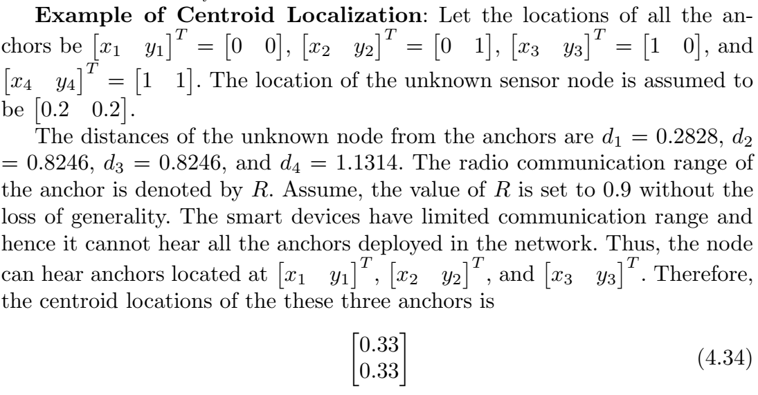

Slide 28
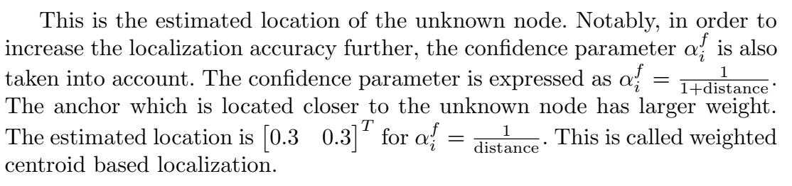

Slide 29
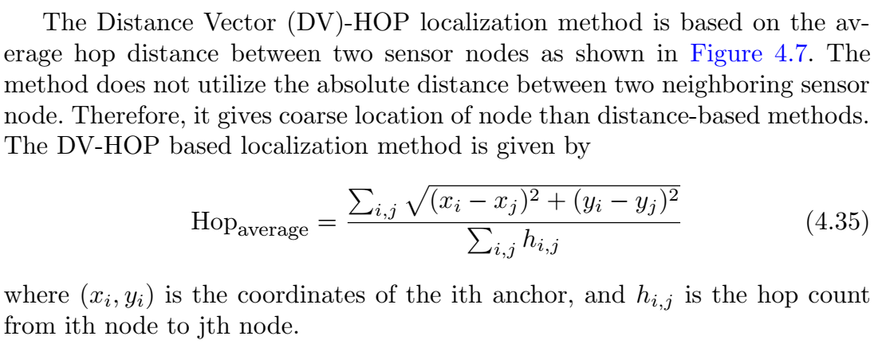
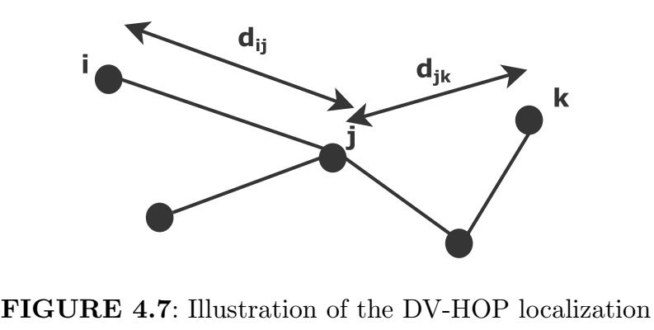
Distance vector hop based localization

Slide 30
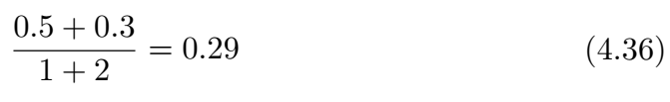
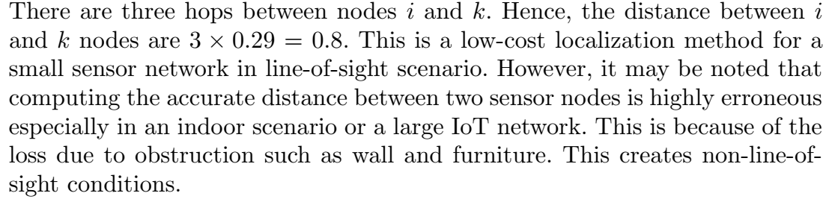
Example of DV Hop Based Localization: Let d_{ij} = 0.5 and d_{jk} = 0.3. The average hop distance using Equation 4.35 is given by

Slide 31
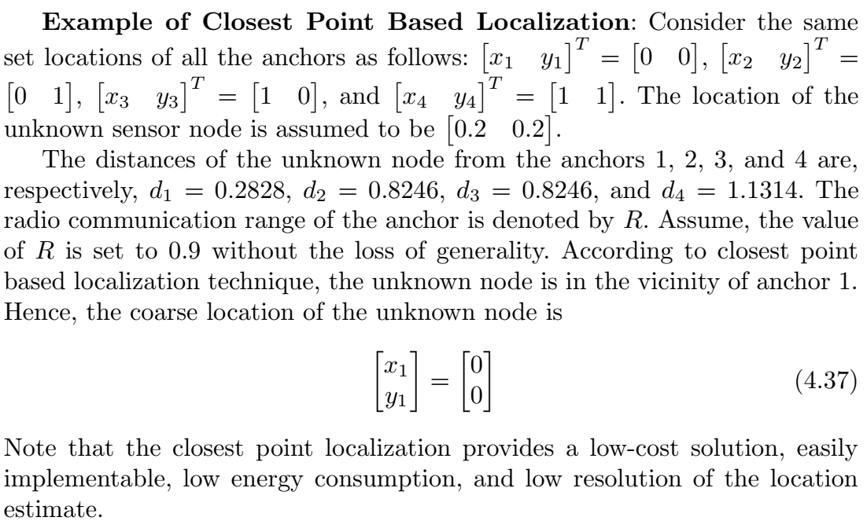
Closest Point Based Localization
The closest point localization method is employed for obtaining the cardinal location information. The coarse location of the unknown sensor node may be decided based on the following conditions:
Which anchor is the closest to node receiving maximum power?
Whether the node is in the communication range of i^{th} anchor?
Direction at which nth node receives maximum energy?
Near-far information between pair of nodes.

Slide 32
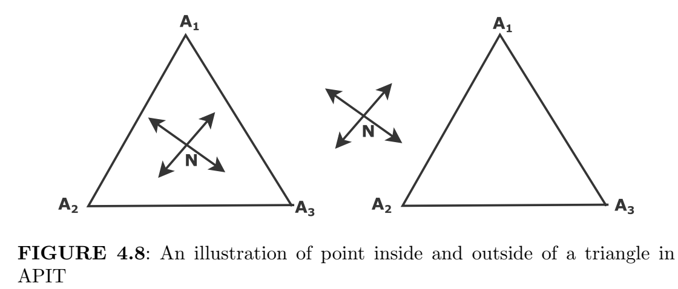
Approximate Point in Triangle Test
We know that a few nodes that are equipped with high-powered transmitters are called anchors. The unknown node can obtain its location based on the information from the anchors.
If there exists a direction of movement such that N is closer or further away to A1, A2, and A3 simultaneously, then N is outside of ∆ A1A2A3 as shown in Figure 4.8.
Otherwise, N is inside ∆ A1A2A3.

Slide 33
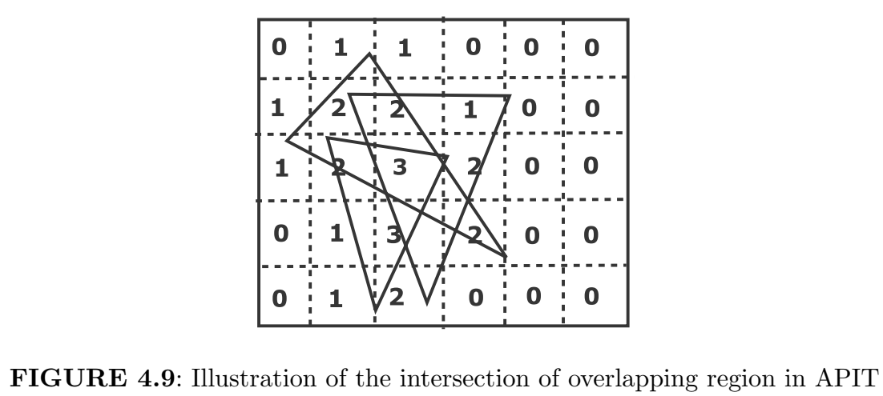

Slide 34
Example of APIT:
First, a grid array is formed and all the grids are initially assigned a zero value as shown in Figure 4.9.
It is then scanned using a grid scan algorithm. If the node lies inside the triangle, it is incremented by one.
The grid array is used to choose the grid where the node is most likely to reside. In this example, the size of the grid is 0.2 times the radio communication range of the sensor.
It is worth mentioning that the number of grids can be increased by decreasing the size for better accuracy.
The number of the possible triangle for our scenario is three for illustration.
However, in practice, all the possible combinations of the triangle are taken into account.
APIT is a cost-effective approach and it has good localization accuracy, even in the presence of irregular radio patterns, and with the random node deployment.

Slide 35
Assumption Based Coordinates (ABC) Localization
Assumption Based Coordinates (ABC) is a distributed localization method.
Initially, it is difficult to get the range measurements from more than three anchors for a 2D coordinate system.
Therefore, a map based on the neighboring ranges is generated at the beginning of the network operation.
The Assumption Based Coordinates (ABC) localization method is shown in Figure 4.10. Here, we consider only positive value after square root operation. If the line joining origin and (x2; y2; 0) subtends an angle ξ with x axis, then we can write using law of cosine as

Slide 36
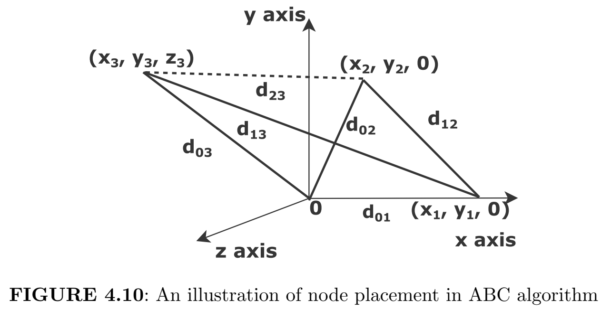

Slide 37
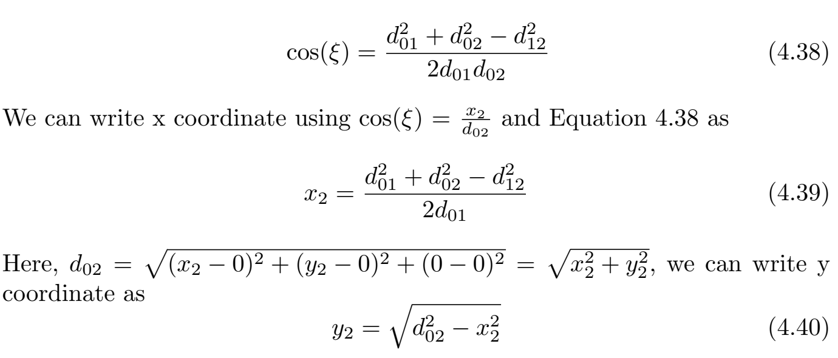

Slide 38
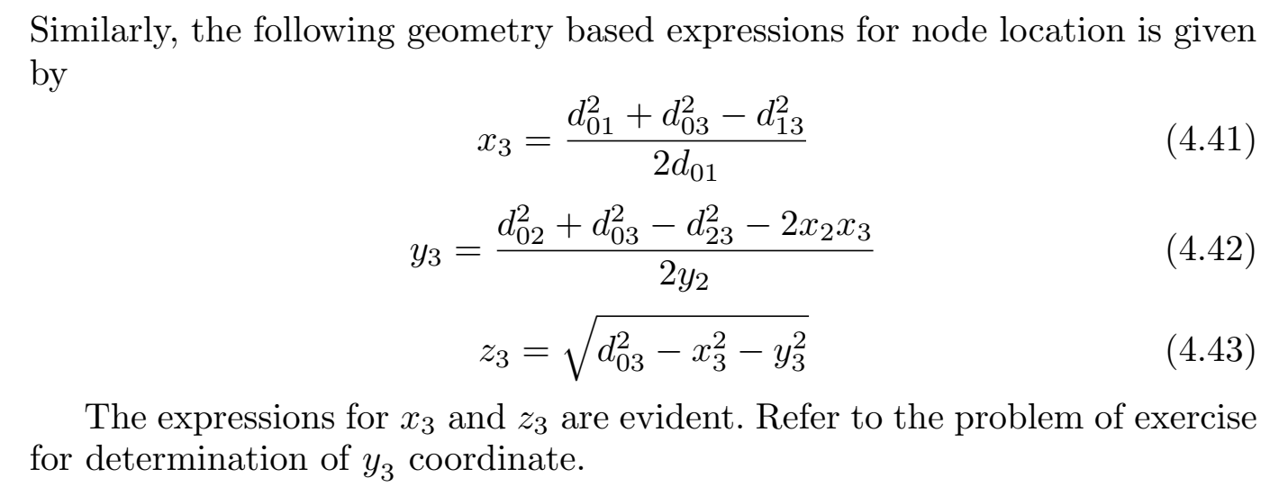

Slide 39
